Slide 1
Migration and Seeding in Laravel

Slide 2
Migration
Migrations are a type of version control for your database. They allow a team to modify the database schema and stay up to date on the current schema state. Migrations are typically paired with the Schema Builder to easily manage your application's schema.

Slide 3
Seeding
An important step towards writing code is being able to test the application with real data. Unit tests are all well and good, but you need to also put your code through full integration tests to ensure everything works correctly as a whole.
Having test data available is also really important for building out the front-end as well as doing Quality Assurance testing within the browser.
In laravel use database seeder. It can be tempting to just grab a copy of your production database and use that as test data, but it’s not worth the risk of accidentally doing something wrong.

Slide 4

To create a migration, you may use the make:migration command on the Artisan CLI:
php artisan make:migration create_users_table

Slide 5
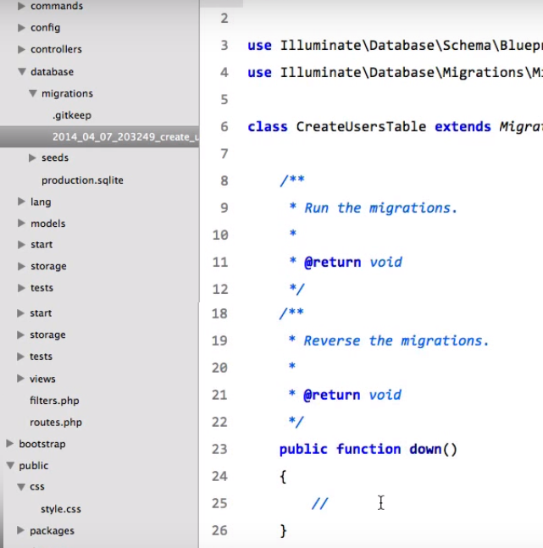


Slide 6
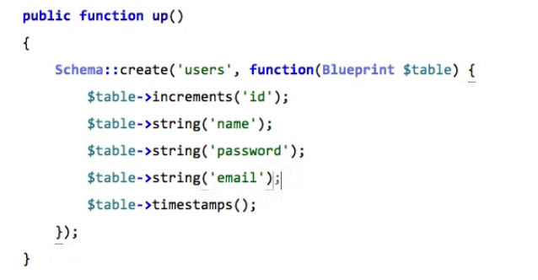

Slide 7
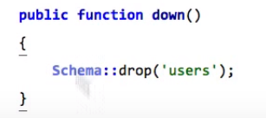

Slide 8
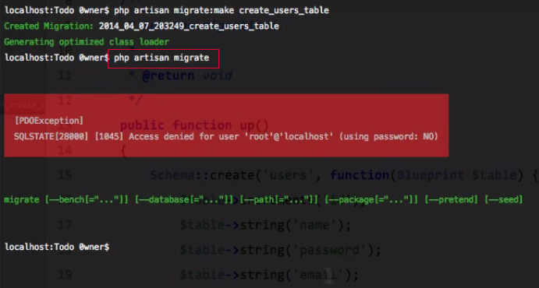
Run Migration

Slide 9
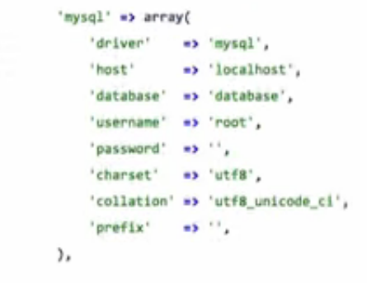
Database.php

Slide 10
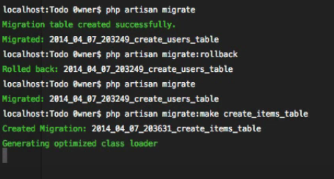
same way, create more tables

Slide 11
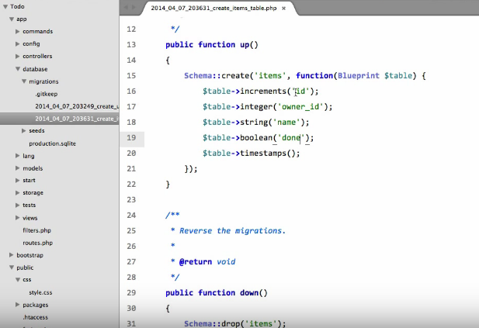
Add fields into table

Slide 12
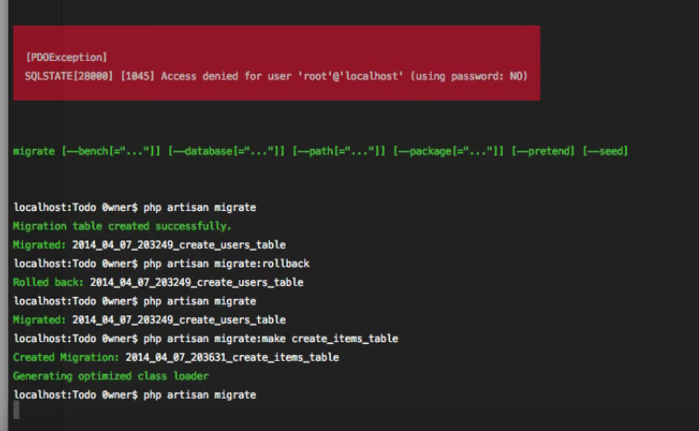

Slide 13
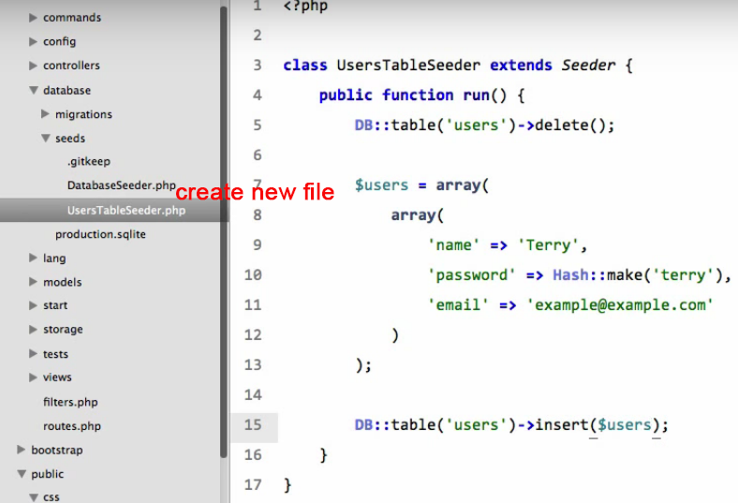

Slide 14
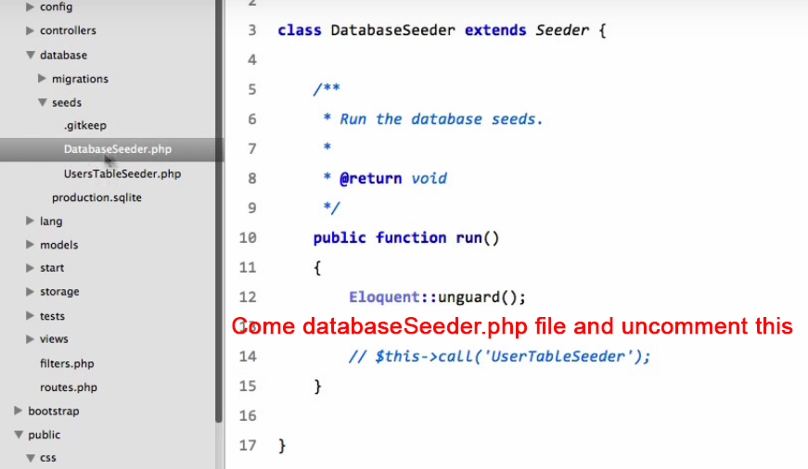

Slide 15
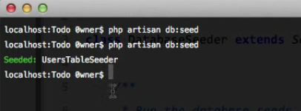

Slide 16
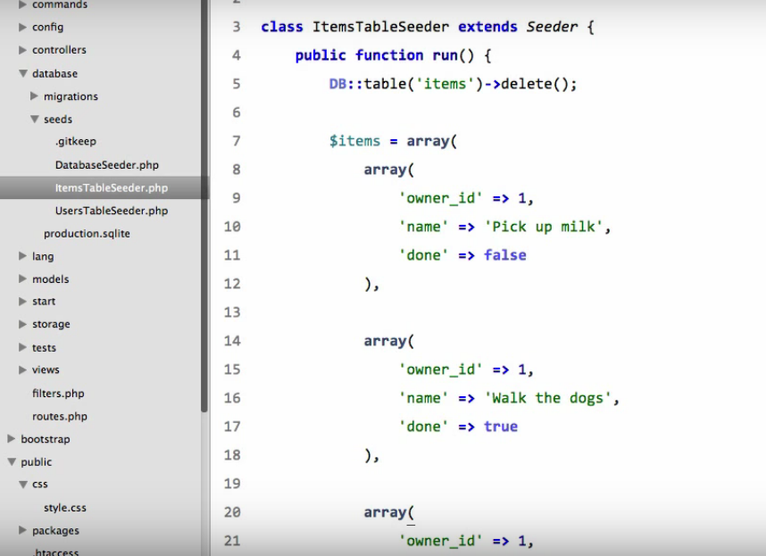

Slide 17
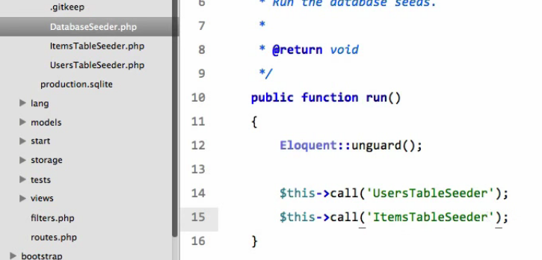

Slide 18
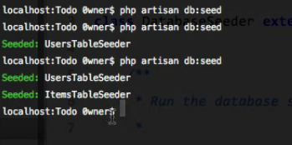

Slide 19
